Slide 1
Uniformly Minimum Variance Unbiased Estimator(UMVUE)
Session 10
03/04/2021

Slide 2
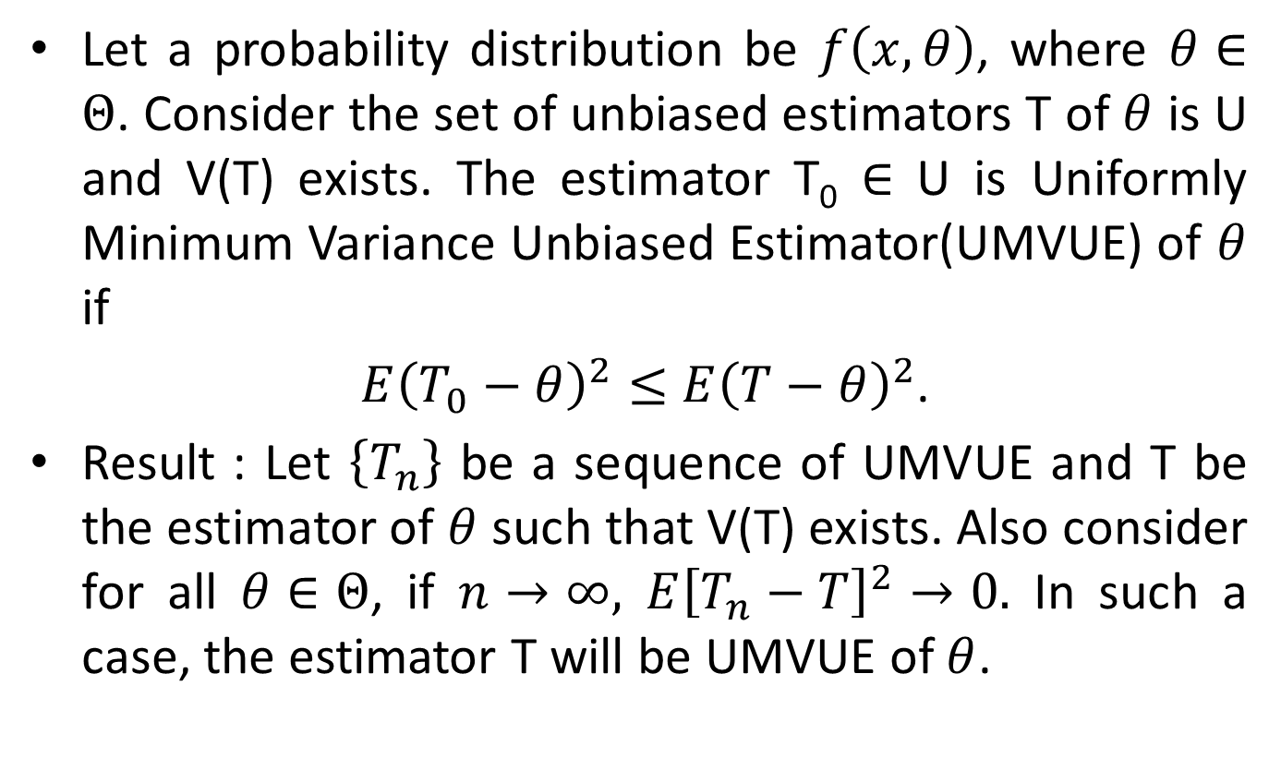
Uniformly Minimum Variance Unbiased Estimator(UMVUE)
Let a probability distribution be $f\left(x,θ\right)$, where $θ∈Θ$. Consider the set of unbiased estimators T of $θ$ is U and V(T) exists. The estimator T₀ $∈$ U is Uniformly Minimum Variance Unbiased Estimator(UMVUE) of $θ$ if
$E{\left(T_{0}−θ\right)}^{2}≤$ $E{\left(T−θ\right)}^{2}$.
Result : Let $\left\{T_{n}\right\}$ be a sequence of UMVUE and T be the estimator of $θ$ such that V(T) exists. Also consider for all $θ∈Θ$, if $n→∞,$ $E{\left[T_{n}−T\right]}^{2}→0.$ In such a case, the estimator T will be UMVUE of $θ$.

Slide 3
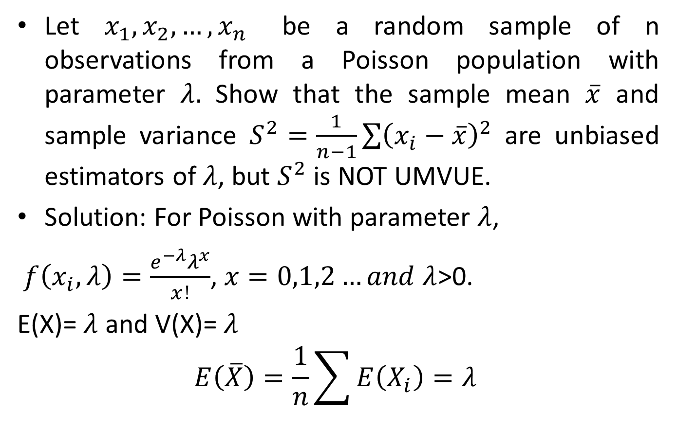
Example 1
Let $x_{1},x_{2},…,x_{n}$ be a random sample of n observations from a Poisson population with parameter $λ.$ Show that the sample mean $\overline{x}$ and sample variance $S^{2}=\frac{1}{n−1}\sum{{\left(x_{i}−\overline{x}\right)}^{2}}$ are unbiased estimators of $λ$, but $S^{2}$ is NOT UMVUE.
Solution: For Poisson with parameter $λ$,
$f\left(x_{i},λ\right)=\frac{e^{−λ}λ^{x}}{x!}$, $x=0,1,2…and λ$>0.
E(X)= $λ$ and V(X)= $λ$
$$E\left(\overline{X}\right)=\frac{1}{n}\sum{E\left(X_{i}\right)=λ }$$

Slide 4
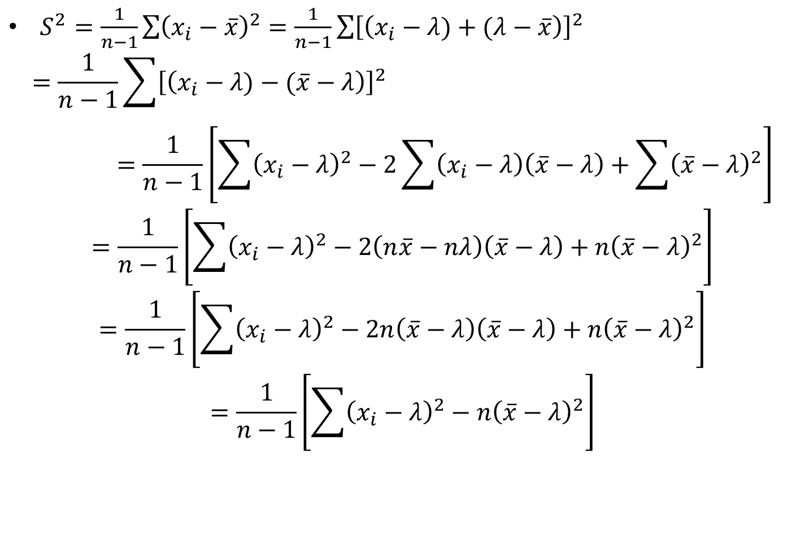
$S^{2}=\frac{1}{n−1}\sum{{\left(x_{i}−\overline{x}\right)}^{2}}=\frac{1}{n−1}\sum{{\left[\left(x_{i}−λ)+(λ−\overline{x}\right)\right]}^{2}}$
$$=\frac{1}{n−1}\sum{{\left[\left(x_{i}−λ)−(\overline{x}−λ\right)\right]}^{2}}=\frac{1}{n−1}\left[\sum{{\left(x_{i}−λ\right)}^{2}−2\sum{\left(x_{i}−λ\right)\left(\overline{x}−λ\right)+\sum{{\left(\overline{x}−λ\right)}^{2}}}}\right]$$
$$=\frac{1}{n−1}\left[\sum{{\left(x_{i}−λ\right)}^{2}−2\left(n\overline{x}−nλ\right)\left(\overline{x}−λ\right)+n{\left(\overline{x}−λ\right)}^{2}}\right]$$
$$=\frac{1}{n−1}\left[\sum{{\left(x_{i}−λ\right)}^{2}−2n\left(\overline{x}−λ\right)\left(\overline{x}−λ\right)+n{\left(\overline{x}−λ\right)}^{2}}\right]$$
$$=\frac{1}{n−1}\left[\sum{{\left(x_{i}−λ\right)}^{2}−n{\left(\overline{x}−λ\right)}^{2}}\right]$$

Slide 5
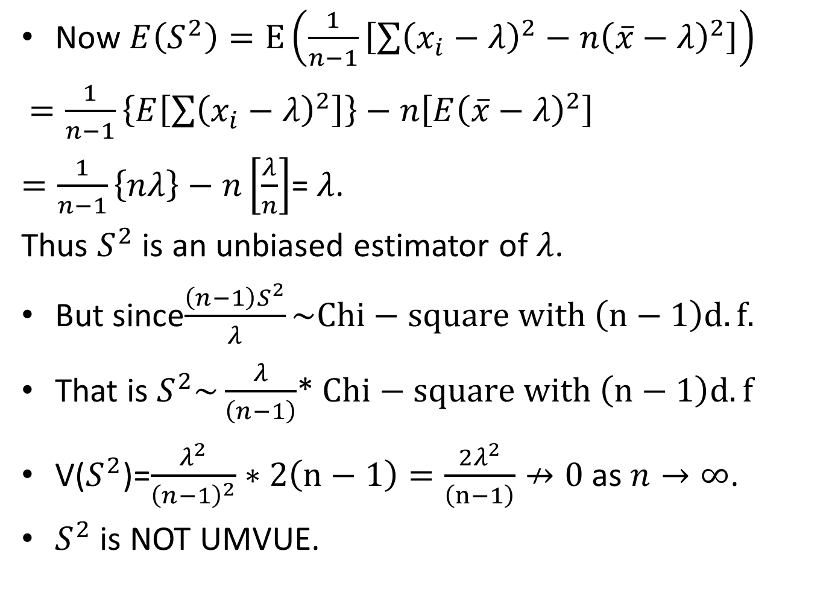
Now $E\left(S^{2}\right)=E\left(\frac{1}{n−1}\left[\sum{{\left(x_{i}−λ\right)}^{2}−n{\left(\overline{x}−λ\right)}^{2}}\right]\right)$
$=\frac{1}{n−1}\left\{E\left[\sum{{\left(x_{i}−λ\right)}^{2}}\right]\right\}−n\left[E{\left(\overline{x}−λ\right)}^{2}\right]$
$=\frac{1}{n−1}\left\{nλ\right\}−n\left[\frac{λ}{n}\right]$= $λ$.
Thus $S^{2}$ is an unbiased estimator of $λ$.
But since$\frac{\left(n−1\right)S^{2}}{λ}\sim Chi−square with \left(n−1\right)d.f.$
That is $S^{2}\sim \frac{λ}{\left(n−1\right)}$* $Chi−square with \left(n−1\right)d.f$
V($S^{2}$)=$\frac{λ^{2}}{{\left(n−1\right)}^{2}}∗2\left(n−1\right)=\frac{2λ^{2}}{\left(n−1\right)}↛0$ as $n→∞$.
$S^{2}$ is NOT UMVUE.

